Slide 1
TITLE:
Blood Donor Web

Slide 2
What is the project about ?
We develop this application to automate the complete operations of the blood bank. They need maintain hundreds of thousands of records. Also searching should be very faster so they can find required details instantly.
To allow the probable recipients to make search and match the volunteer donors, and make request for the blood.
To provide an efficient donor to user.
To provide immediate storage and retrieval of data and information.
User friendly system.
Easy to use and efficient computerized system.
To develop an accurate and flexible system, it will eliminate
Less chances of information leakage. Provides security to data by using login & password.

Slide 3
Problem Statement
Inability of modification of data:
The managing of huge data effectively and efficiently for efficient. Results, storing the details of employee’s task in such a way that the database can be modified as not possible in the current system.
Manual operator control:
Manual operator control is there and leads to a lot of chaos and errors.

Slide 4
Modules:
There are some module used in the system which are as follows,
User: In user module, Registered user can login using there login name and password. After login user can search for donor as per there requirement. After getting result of search user can send the request for donor. After getting the acceptance of request user get SMS and all detail information about donor as well as donor also getting SMS and information about User. User also has facility to change their password.
Admin: In admin module, admin get notification of user requests. Admin have rights to accept or reject request. Admin send the SMS after accepting the request of user to both user and donor. Admin can see the all registered users list.

Slide 5
Admin:
Login
View Registered Donors
Search Donors
User:
Registration
Login
Edit Profile
Search Donors
Change Password
Logout

Slide 6
Software Requirements :-
Operating System : windows 7, windows 8 and Upper version
Web Browser : IE6 or upwards, Google Chrome, Mozilla Firefox
Web Server : IIS 7.0
IDE Tools : Microsoft Visual Studio
Front End : Asp.Net
Database/Back End : Microsoft SQL Server
Language Structure : C#

Slide 7
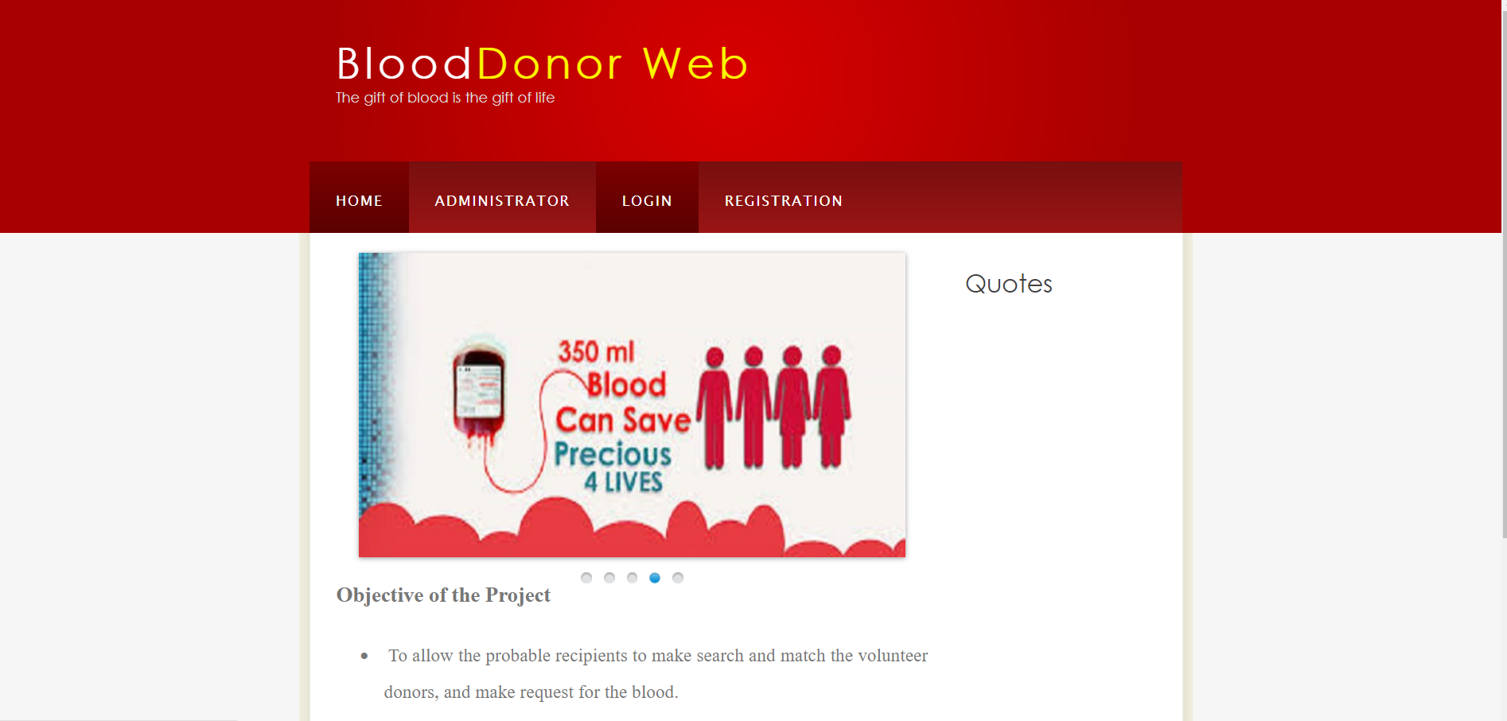
Photos while working

Slide 8
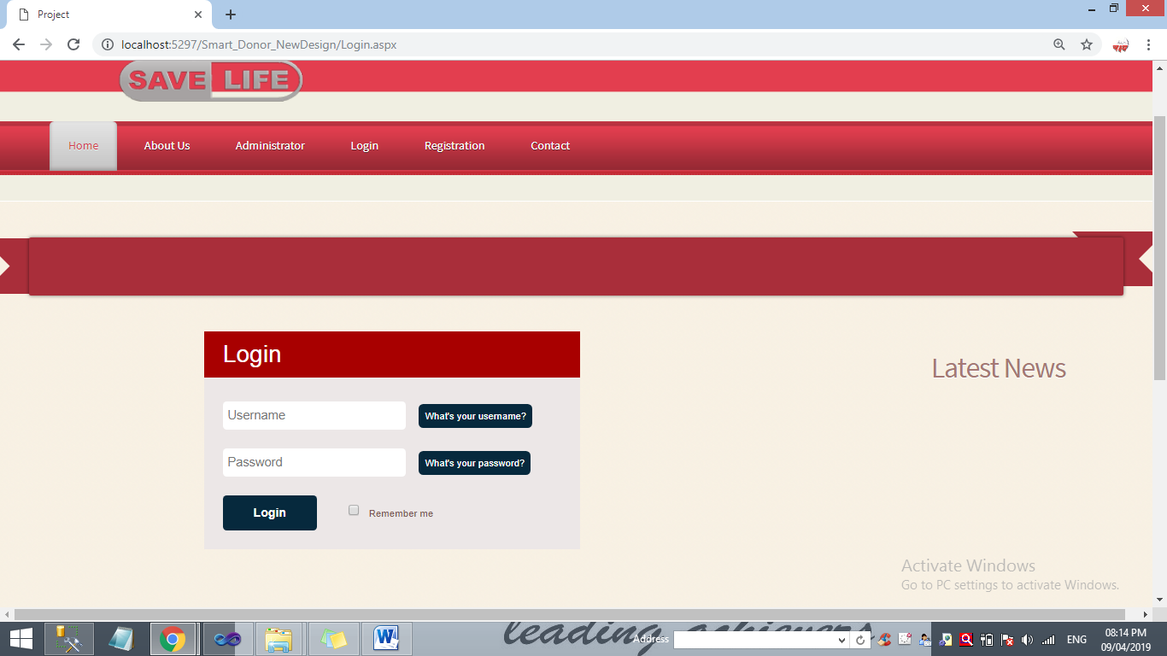
Login Form

Slide 9
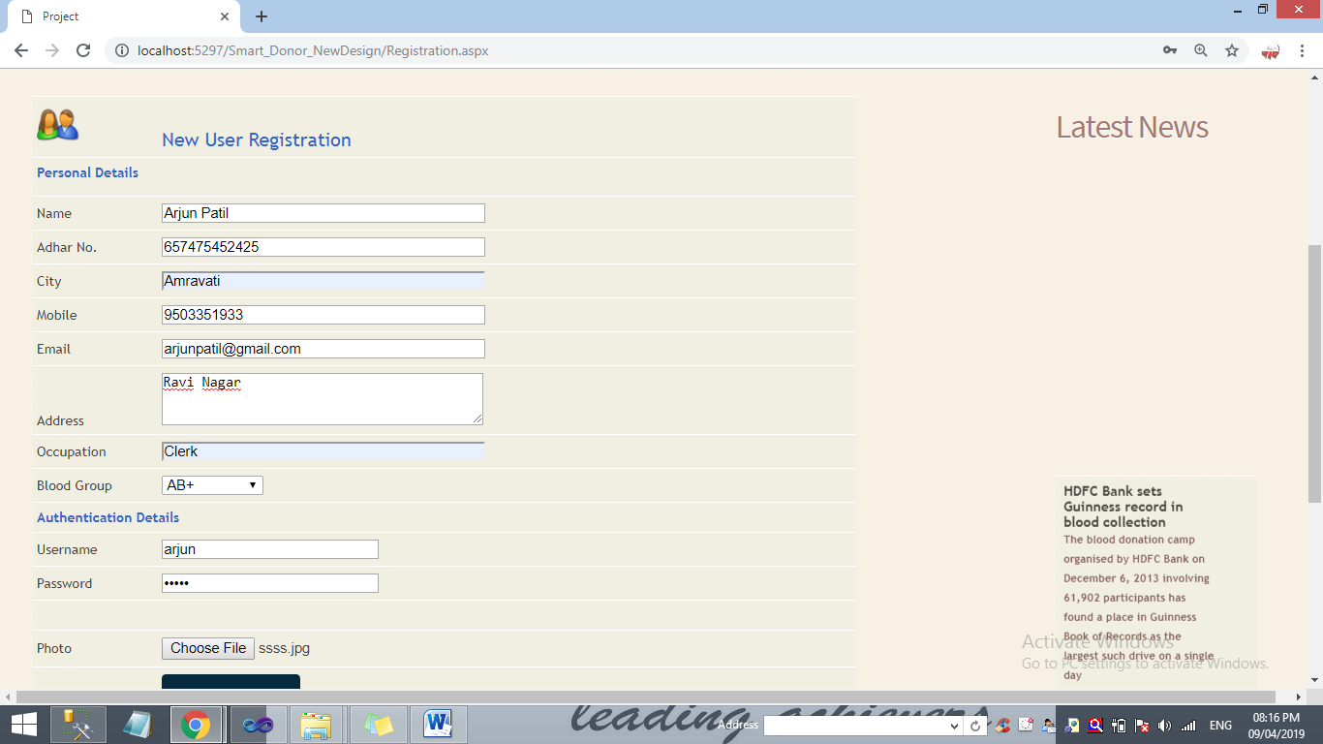
Registration Form

Slide 10
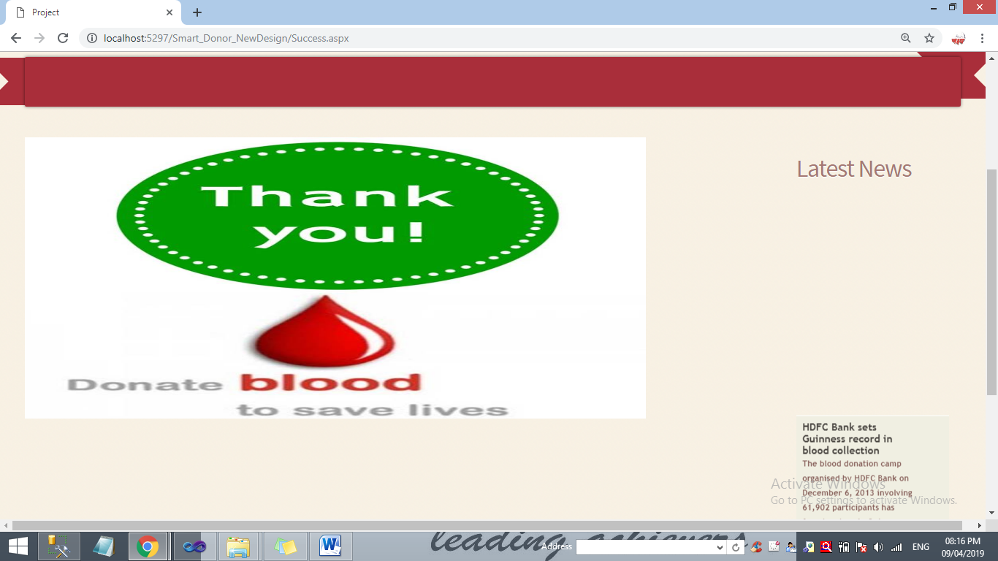
After Registation

Slide 11
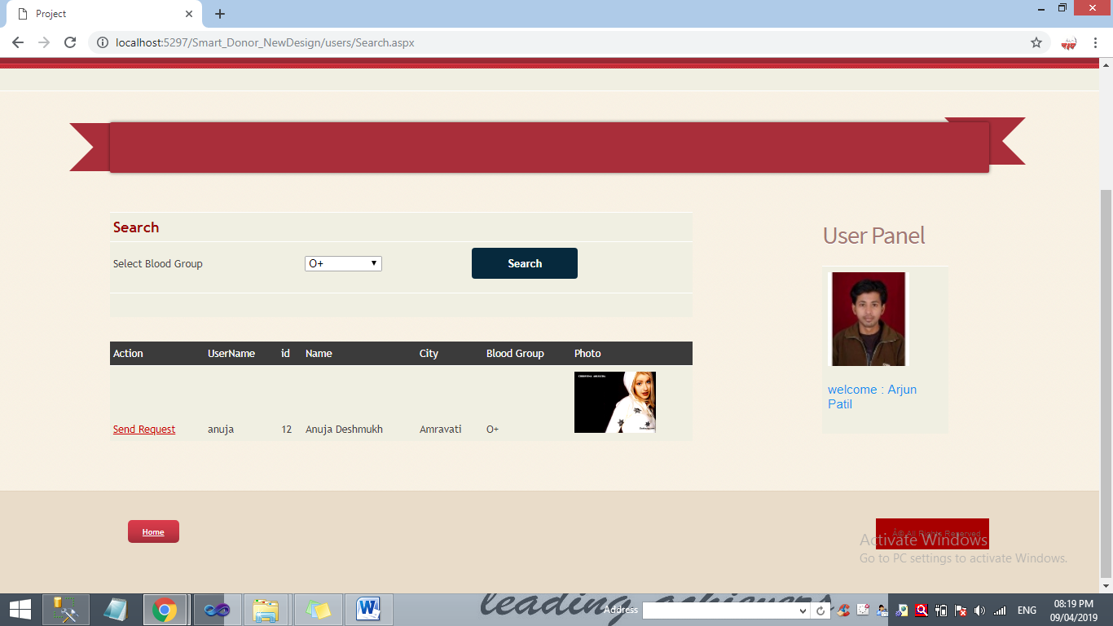
Search Doner

Slide 12
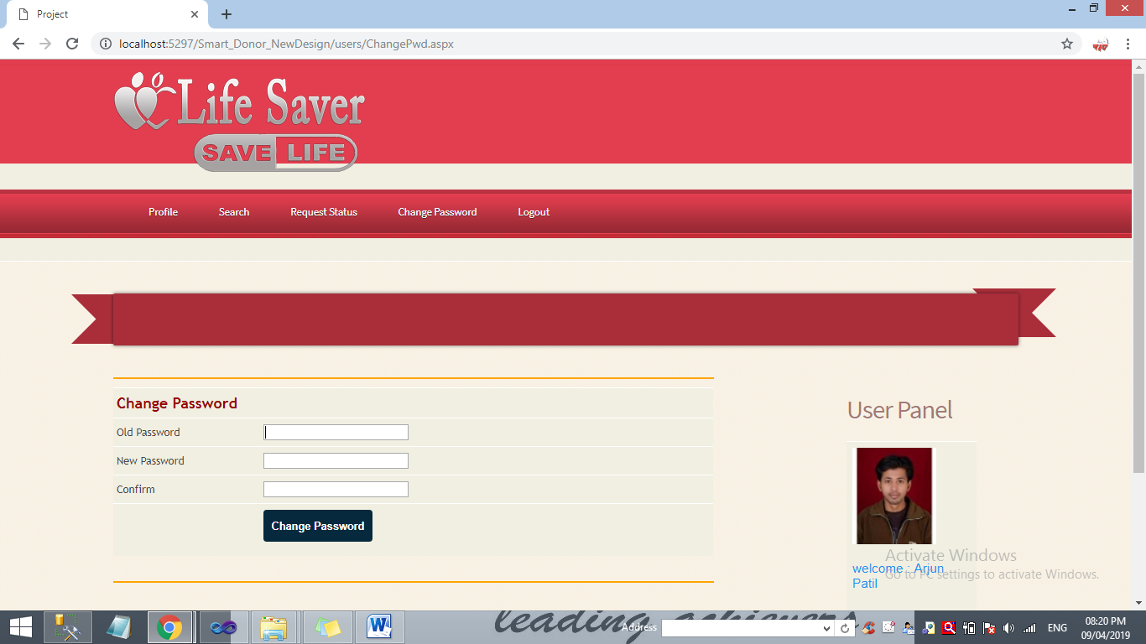
Change Password

Slide 13
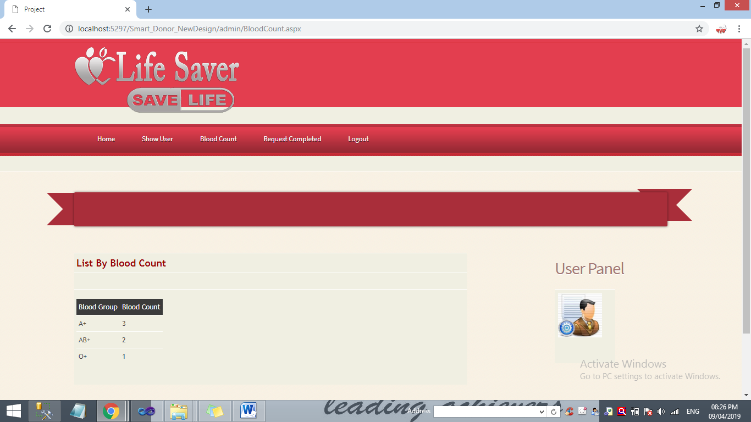
Total Blood Count

Slide 14
Conclusion:
In this project user can request the donor for specific blood group. The admin can handled the user requests if admin confirm the given request then SMS will be sent on registered mobile number of user. Also user and admin can view the status of the request in the login panel. The person who need blood donor then they can search and find blood donors by using our application. User can get brief details about their contact details including their location after accepting there request by admin. Donor and accepter both get the all details through SMS. The user can make a call or message directly by using our application. The application can be further expanded by following the future Enhancements mentioned above

Slide 15
Future Scope
By adding more features in the future it is expected that this system will go long way in a satisfying administrator requirements. The system is able to achieve the objective and provide the ultimate result.

Slide 16
Thank You.

